Slide 1
Global Bank User Management
Wells Fargo Capstone Project

Slide 2
Team members
Shravya Thatipalli
Kunal Mitra
Mehul Kavdia
Shreerang Bhat

Slide 3
Problem Statement
Every customer of a bank need to perform few very basic activities like managing their accounts,making transactions,viewing their transactions over a period of time,submitting loan applications,viewing their active loans etc on a regular basis.Continuous increase in number of client visiting the bank for their every basic need is very inefficient and a time consuming process . Recording and maintaining all the client records manually is highly unreliable, inefficient and error prone. It is for this need that a user friendly application is built where any user holding an account with the bank can perform all the basic banking activities from anywhere.

Slide 4
Project Scope
Global Bank User Management App provides the account holders of the bank an easy way to register themselves with the bank, apply for loans, view their loans, create and view their transactions. Our app provides a user-friendly interface with self-explanatory modules and easy navigation throughout the app.
Assumptions
Customers already have an account with the bank.
Transactions are only logical transactions not physical ones.

Slide 5
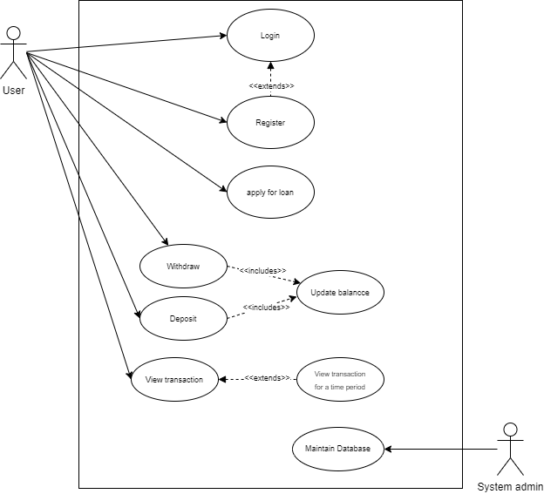
Use case Diagram

Slide 6
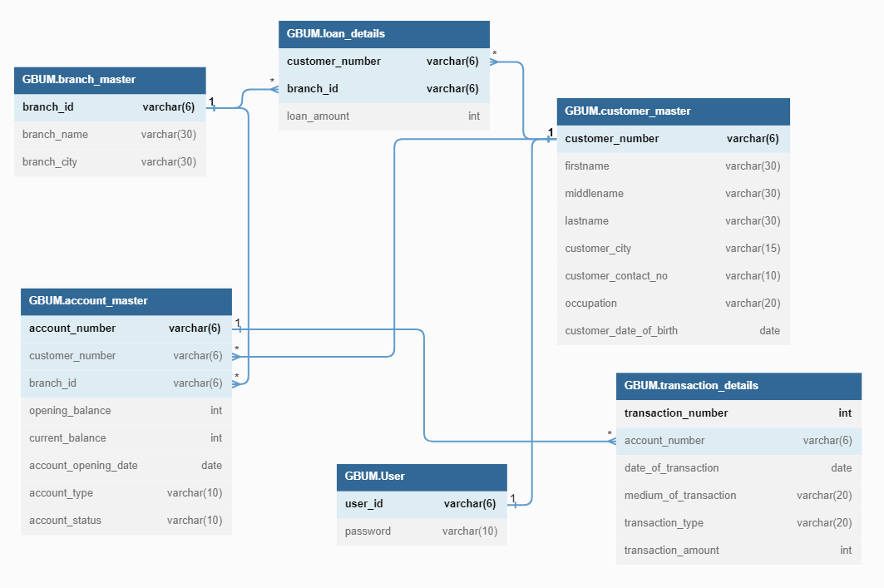
Schema Diagram

Slide 7
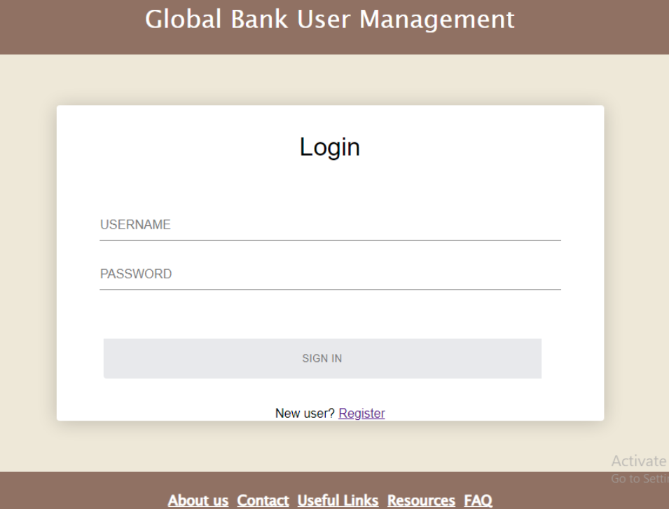
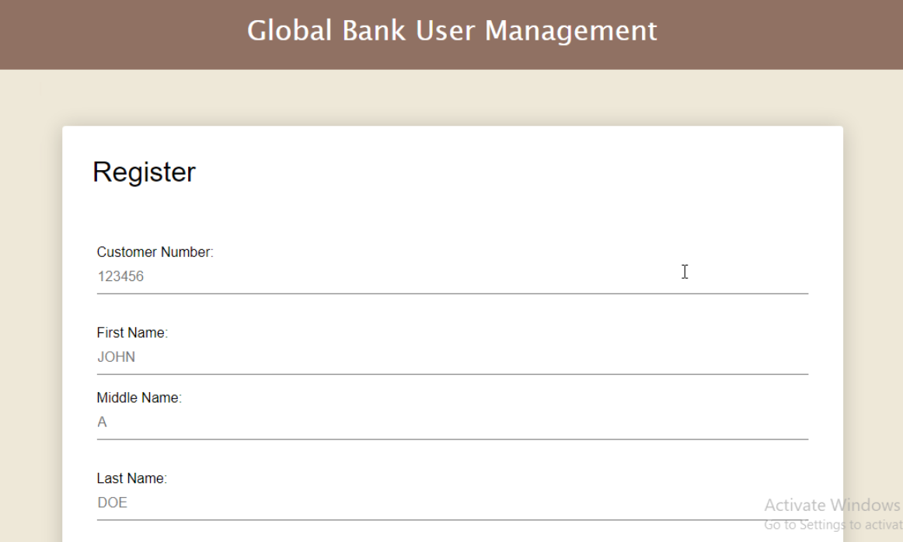
Login Page and Registration Page

Slide 8
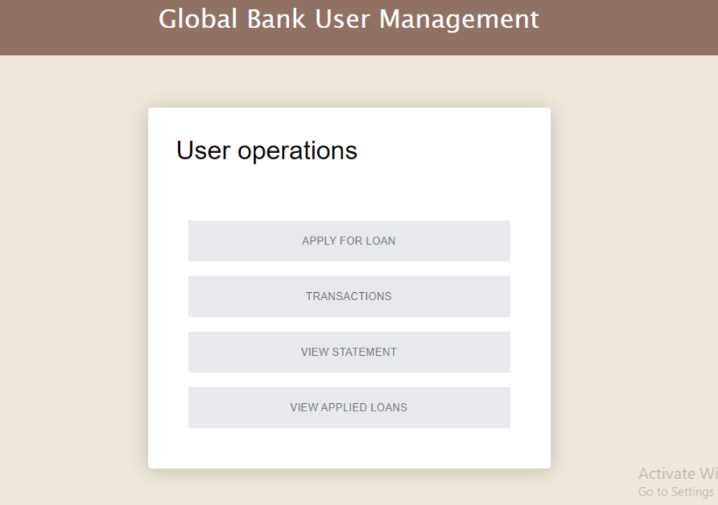
User Operations Page

Slide 9
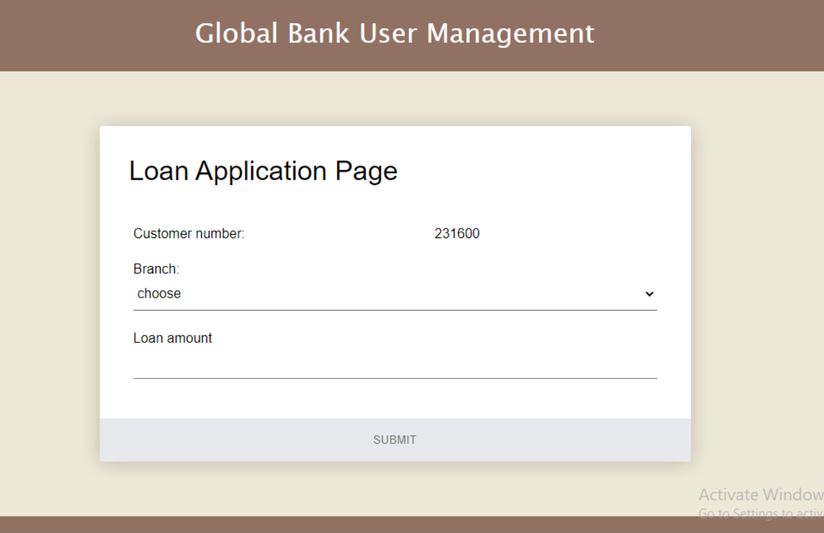
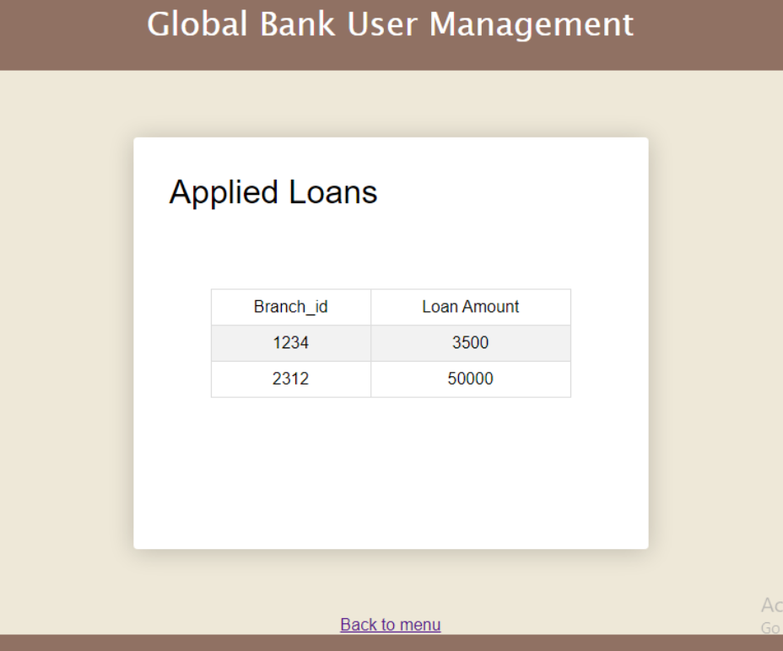
Loan Application Page and View Loans Page

Slide 10
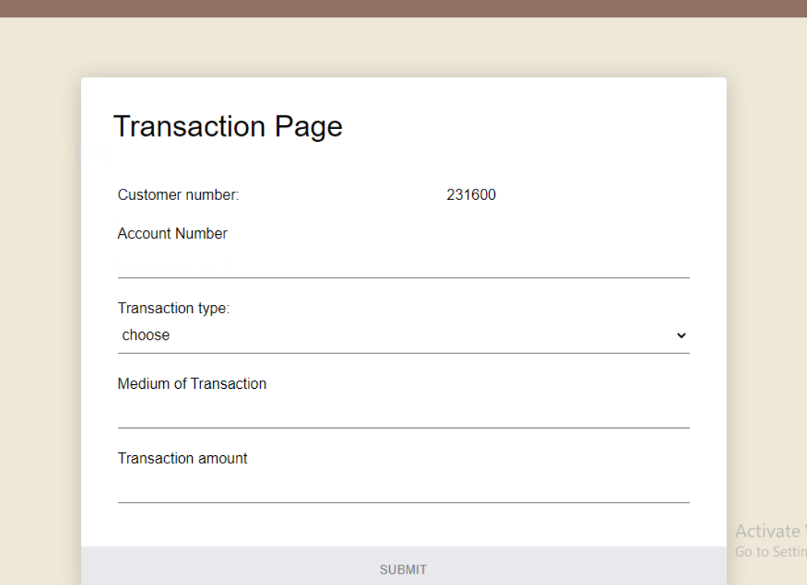
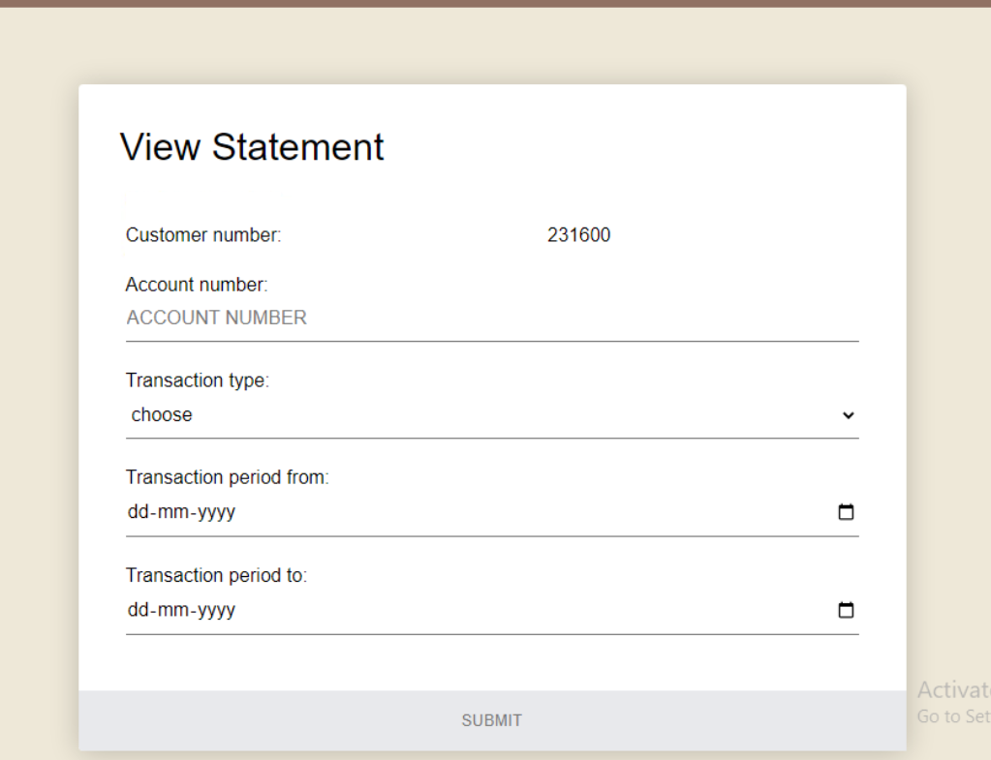
Transaction Page and View Statement Page

Slide 11
Thank you

